Slide 1
INTRODUCTION TO SEROLOGY
by
Mwesigwa Alex

Slide 2
Objectives
By the end of this module, learners should be able to carry out the following Serological Tests
1: Screen for HIV using M.O.H Algorithm
2: Test for Syphilis
3: Carry out Human Chorionic Gonaedotrophin(HCG) test
4: Carry out Brucella Agglutination Test (BAT)
5: Carry out Rheumatoid Factor Test
6: Carry out Hepatitis test .
7: Carry out Serum Crag
8: Carry out Helicobacter pylori test
9: Perform quality control

Slide 3
SEROLOGY
Definition:
The branch of science dealing with the measurement and characterization of antibodies, antigens, and other immunological substances in body fluids (serum) or even plants that are virus-infected.

Slide 4
Types of serological tests used in the clinical laboratory
  1. Agglutination
    Principles of agglutination reactions
    Types of agglutination i.e. Slide/tile agglutination and tube agglutination,
(a) Tube agglutination
  Measurement of antibodies in serum (Titre)
  Prozone phenomenon/effect

Slide 5
Types of serological tests used in the clinical laboratory con’d
(b) Slide agglutination
Carriers used in slide agglutination
  Latex particles
  Carbon particles
  Stabilized Staphylococcal cells
    Examples and methods of performing agglutination tests WIDAL, Pregnancy test, Brucella Agglutination Test, Rheumatoid factor

Slide 6
Types of serological tests used in the clinical laboratory con’d
  (2) Precipitation reactions
Principles of precipitation reactions
Types of precipitation techniques;
  Tube precipitation test
  Gel precipitation test
-Counter immuno electrophoresis

Slide 7
Gel precipitation test
  Types of Gel precipitation test
  Gel diffusion
  Double gel diffusion
  Single radio diffusion

Slide 8
(3) Immunofluorescent test
Principle of immnofluorescent test
Types of immunofluorescent antibody test
-Direct immunofluorescent antibody test
-Indirect immunofluorescent antibody test
-Control of immuno fluorescent reagents

Slide 9
(4) Enzyme linked immunosobent Assay (ELISA)
Principle of ELISA
Types of performing ELISA;
  Double antibody technique to detect antigen
- Direct ELISA
-Indirect ELISA
-Sandwich ELISA
-Competitive ELISA

Slide 10
(5) Complement fixation test
Principle of complement fixation tests
    Use of complement fixation tests
(6) Radio immuno assays
Principle radio immuno assay
Types of radio immuno assay

Slide 11
AGGLUTINATION TEST

Slide 12
Agglutination test
Definition
The interaction between antibody and a particulate antigen results in visible clumping called agglutination.
Particulate antigen include:
  bacteria,
  white blood cells,
  red blood cells,
  latex particles
  Carbon particles
Antibodies that produce such reactions are called agglutinins.

Slide 13
Agglutinin and Agglutinogen
An agglutinin is an antibody that interacts with antigen on the surface of particles such as erythrocytes, bacteria, or latex particles to cause their agglutination in an aqueous environment containing electrolyte.
An agglutinogen is an antigen on the surface of particles such as red blood cells that react with the antibody known as agglutinin to produce agglutination. The most widely known agglutinogens are those of the ABO and related blood group systems.

Slide 14
Agglutination is the basis for multiple serological reactions including:
  blood grouping,
  diagnosis of infectious diseases
  and noninfectious diseases

Slide 15
Agglutination is a secondary manifestation of antigen–antibody interaction.
As specific antibody crosslinks particulate antigens, aggregates form that become macroscopically visible and settle out of suspension.
Thus, the agglutination reaction has a sensitivity 10 to 500 times greater than that of the precipitin test with respect to antibody detection.
Agglutination permits phagocytic cells to engulf invading microorganisms. This is a major role of agglutinin in the immune reaction.

Slide 16
Agglutination & Precipitation
Agglutination reactions are similar in principle to precipitation reactions; they depend on the cross linking of polyvalent antigens with the exception that:
precipitation reactions involve soluble antigens, while agglutination involves particulate antigens
precipitation reactions represent a phase change, while the agglutination reactions manifest as clumping of antigen/ antibody complexes.

Slide 17
Advantages of Agglutination Techniques
The agglutination reaction has wide spread use in the clinical laboratory. The reason for the popularity of agglutination tests is that:
  they are simple,
  inexpensive,
  and reliable.
The visible manifestation of the agglutination reaction eliminates the need for complex procedures and expensive instrumentation.
Numerous techniques have been described for agglutination tests. These techniques may be performed using:
  slides,
  test tubes,
  or micotiter plates, depending on the purpose of the test.
However the principle of the agglutination remain the same.

Slide 18
Qualitative Agglutination Test
Agglutination tests can be used in a qualitative manner to assay for the presence of an antigen or an antibody.
The antibody is mixed with the particulate antigen and a positive test is indicated by the agglutination of the particulate antigen.
For example, a patient’s red blood cells can be mixed with antibody to a blood group antigen to determine a person’s blood type.
In a second example, a patient’s serum is mixed with red blood cells of a known blood type to assay for the presence of antibodies to that blood type in the patient’s serum. This test can be done on a slide.

Slide 19
Quantitative Agglutination Test
Agglutination tests can also be used to quantitate the level of antibodies to particulate antigens.
In this test
one makes serial dilutions of a sample to be tested for antibody
and then adds a fixed number of red blood cells or bacteria or other such particulate antigen
and determines the maximum dilution, which gives agglutination.
The maximum dilution that gives visible agglutination is called the titer.
The results are reported as the reciprocal of the maximal dilution that gives visible agglutination. This can be done using a microtiter plate.

Slide 20
Quantitative Agglutination Test
1/2
1/4
1/8
1/16
1/32
1/64
1/128
1/256
1/512
1/1024
Pos.
Neg.
Patient
Titer
1
64
2
8
3
512
4
<2
5
32
6
128
7
32
8
4

Slide 21
Determining Antibody titer
Titer is the quantity of a substance required to produce a reaction with a given volume of another substance.
Antibody titer is the highest dilution of the biological sample that still results in agglutination, with no agglutination being observed at any higher dilution.
Titer is an approximation of the antibody activity in each unit volume of a serum sample.
The term is used in serological reactions and is determined by preparing serial dilutions of antibody to which a constant amount of antigen is added.

Slide 22
Determining Antibody titer
Serial dilution of the serum can be performed in a microtiter plate or tubes.
The end point is the highest dilution of antiserum in which a visible reaction with antigen can be detected.
The titer is expressed as the reciprocal of the serum dilution which defines the endpoint.

Slide 23
Determining Antibody titer
 | Prozone |  |  |  |  | Equivalence Zone |  |  |  | Post Zone
Serum Dilution | 1:10 | 1:20 | 1:40 | 1:80 | 1:160 | 1:320 | 1:640 | 1:1280 | 1:2560 | 1:5120
Antigen Conc. | X | X | X | X | X | X | X | X | X | X
Agglutination | – | – | + | ++ | +++ | ++++ | +++ | ++ | + | –

Slide 24
Steps in Agglutination
Sensitization
  Agglutination is a two-step process that results in the formation of a stable lattice network. The first reaction involves antigen-antibody combination through single antigenic determinants on the particle surface and is often called sensitization.
Lattice formation
  The second stage representing the sum of interactions between antibody and multiple antigenic determinants on a particle, is dependent on environmental conditions and the relative concentrations of antigen and antibody.

Slide 25
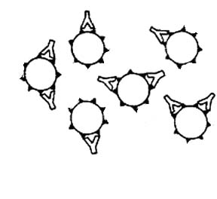
This represents what occurs during stage one of agglutination: Sensitization
Stage 1
Antibody molecules attach to their corresponding Antigenic site (epitope) on the red blood cell membrane. There is no visible clumping.

Slide 26
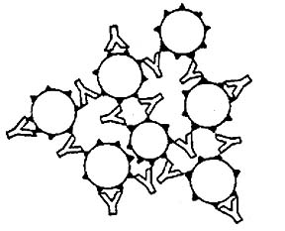
This represents what occurs during stage 2 of agglutination: Lattice Formation
Stage 2
Antibody molecules crosslink RBCs forming a lattice that results in visible clumping or agglutination.

Slide 27
Factors that Affect Agglutination
The agglutination reaction may be used to identify the antibody or antigen in a patient sample.
When testing for antibody, the antigen concentration is constant for each dilution being tested.
When testing for antigen, the antibody concentration is constant for each dilution being tested.

Slide 28
Factors that Affect Agglutination
The assumption is made that antibody in the patient's sample is the unknown parameter.
The particulate antigen with antibodies is affected by several factors, including the following:
  Buffer pH
  The relative concentration of Antibody and Antigen
  Location and concentration of Antigenic Determinants on the Particle
  Electrostatic Interactions between Particles
  Electrolyte Concentration
  Antibody Isotype
  Temperature

Slide 29
Buffer pH
The buffer pH (H+ ion concentration) affects overall charge on the antigens and the antibodies.
The pH should be close to physiological pH to more closely resemble in vivo conditions.

Slide 30
The relative concentration of Antibody and Antigen
Lattice formation and agglutination occur only when the antigen and antibody are present in the appropriate concentration, forming a zone of equivalence.
It is important to predetermine the appropriate concentration of antigen that is to be added to the various dilutions of serum.
Only one concentration of antigen is applied in each well and a dilution of the serum is added to each.

Slide 31
Location and concentration of Antigenic Determinants on the Particle
The location of the antigenic determinants on the particle is a significant factor
Antibodies will not readily detect antigenic determinants buried within the particle.
The concentration of the antigenic determinants is also important
  as the number of antigenic determinants increases, the likelihood that cross-bridging of antibodies will occur is much higher.
  if too much space exists between the antigenic determinants, agglutination is decreased.

Slide 32
Electrostatic Interactions between Particles
Play an important role in the agglutination reaction,
Antigen and antibody complex formation is based on noncovalent interactions, one of which is electrostatic interaction.
Electrostatic repulsion between similarly charged antigen particles also plays an important role when repulsion limits the proximity to which these particles can approach one another.

Slide 33
Electrolyte Concentration
Electrolytes are required for agglutination reaction to occur.
The actual concentration of electrolytes (ionic strength) in the buffer plays an important role in agglutination of some antigens
  at neutral pH high concentration of electrolytes neutralize the negative charges on particles.
  electrolytes reduce the electrostatic charges that interfere with lattice formation.

Slide 34
Antibody Isotype
Secreted IgM is a pentameric molecule and as such it is a more effective agglutinin than IgG.
The pentameric IgM allows more antigens to bind to one antibody molecule,
  therefore, cross-linking
  and hence lattice formation occur more readily.
Also, the size of the IgM antibody compared to that of IgG allows bridging despite the presence of sialic acid on the red blood cell surface.
This is because the maximal potential distance between one Fab region and another on the pentameric IgM antibody molecule is greater than that for IgG.
As a result, agglutination of red blood cells can proceed in the presence of IgM antibodies that recognize cell surface antigens.

Slide 35
Temperature
Some antigens bind to antibodies at 37ºC, while others bind best at 4ºC.
Antibodies that exhibit maximal reactivity with antigen at temp. in the range of 0ºC to 10ºC are referred as cold agglutinins.
The rate of agglutination increases rapidly from 0 to 30ºC. Above that temperature it is less rapid, and above 56ºC the antibody molecules are denatured by heat.

Slide 36
Types of Agglutination
Direct agglutination
Indirect or Passive agglutination
Reverse passive agglutination
Hemagglutination
Latex agglutination
Agglutination inhibition / Hemagglutination inhibition
Coagglutination
Viral Hemagglutination

Slide 37
Direct agglutination
In this reaction the antigen is an intrinsic component of the particle.
The agglutination test is used to determine whether antibody, specific for the antigen is present in the biological fluids
    serum,
    urine
    or CSF.
Direct agglutination tests are used primarily for diagnosis of infectious diseases.

Slide 38
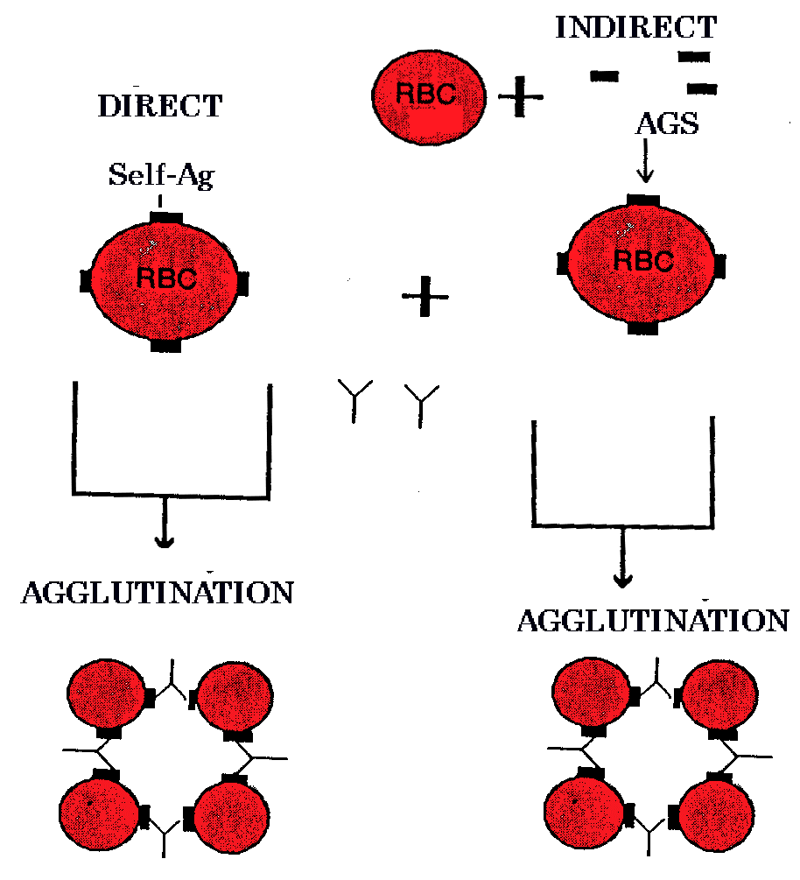
Direct agglutination

Slide 39
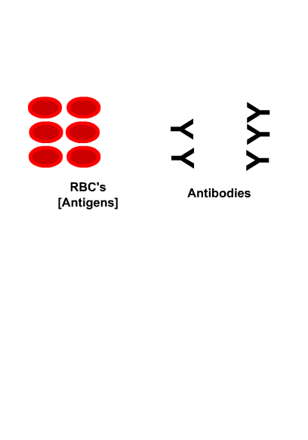
Direct agglutination
Occurs when the antigenic determinant is inherent to the particle itself. (naturally)
Example 1– Using group A rbc’s to detect anti-A in serum.

Slide 40
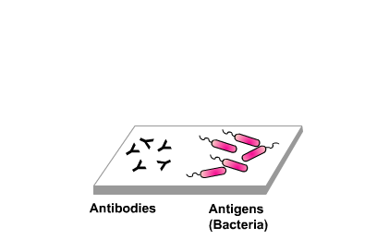
Direct agglutination
Example 2 – Using bacteria (Ag) looking for Ab in serum.

Slide 41
Indirect Agglutination
Antigen has been affixed or adsorbed to the particle surface.
Red blood cells were used as particles for indirect agglutination, however, their use for indirect agglutination has decreased.
The commercial availability of latex or other inert particles to which antigen is affixed has replaced RBCs.
Indirect agglutination allows testing of organisms that are very pathogenic without the need to maintain cultures because only the immunologically dominant molecules are affixed to the particles, not the intact organism.

Slide 42
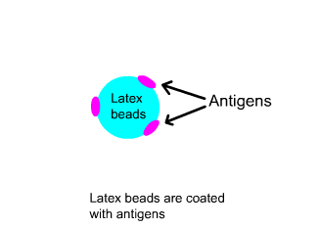
Latex Agglutination
Very popular in clinical laboratories.
These tests have been applied to the detection many infectious diseases, and many other applications are currently available.
The first description was the Rheumatoid Factor
Test proposed by Singer and Plotz in 1956.
Since then, tests to detect
  microbial
  and viral infections,
  autoimmune diseases,
  hormones,
  drugs
  and serum proteins have been developed

Slide 43
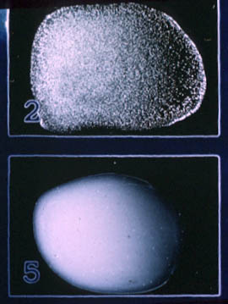
Latex Agglutination
In latex agglutination procedures, an antibody (or antigen) coats the surface of latex particles (sensitized latex).
When a sample containing the specific antigen (or antibody) is mixed with the milky-appearing sensitized latex, it causes visible agglutination.

Slide 44
The Latex particles
Latex particles are usually prepared by emulsion polymerization.
Styrene is mixed into a surfactant (sodium dodecyl sulfate) solution, resulting emulsified in billions of micelles extremely uniform in diameter.
Water-soluble polymerization initiator such as potassium persulfate is added.
When the polymerization is finished, polystyrene chains are arranged into the micelles with the hydrocarbon part in the center and the terminal sulfate ions on the surface of the sphere, exposed to the water phase.
Notes:
An emulsion is a mixture of two immiscible (unblendable) substances.
A micelle is an aggregate of surfactant molecules dispersed in a liquid colloid. A typical micelle in aqueous solution forms an aggregate with the hydrophilic "head" regions in contact with surrounding solvent, sequestering the hydrophobic tail regions in the micelle centre
Styrene, is an organic compound with the chemical formula C6H5CH=CH2. Under normal conditions, this aromatic hydrocarbon is an oily liquid. Styrene is the precursor to polystyrene, an important synthetic material.

Slide 45
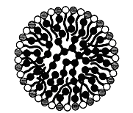
The Latex particles
Black ball chains represents polystyrene with sulfate free radicals (shaded balls). White balls denote the sulfonic acid group of the SDS. Tail represent the hydrocarbon tail.

Slide 46
Coating of the Latex Particles
The simplest method of attaching proteins to the particles is by passive adsorption.
Latex and proteins are mixed in an appropriate buffer solution, allowed to reach an equilibrium and washed several times until the latex is free of any residual unadsorbed protein.
Another method is by covalently coupling the molecule to the particle surface.

Slide 47
APPLICATION OF AGGLUTINATION TEST IN THE DIAGNOSIS OF INFECTIOUS DISEASES

Slide 48
1. Rheumatoid Factor Latex Slide Test
To detect the presence of Rheumatoid arthritis in clinical specimens

Slide 49
Introduction
Rheumatoid Factors (RF) are antibodies directed against antigenic sites in the Fc fragment of human IgG.
Their frequent occurrence in rheumatoid arthritis makes them useful for diagnosis and monitoring of the disease.
One method used for rheumatoid factor detection is based on the ability of rheumatoid arthritis sera to agglutinate sensitized latex particles.
The major advantage of this method is rapid performance and lack of heterophile antibody interference.
Notes:
Heterophile antibodies are antibodies induced by external antigens (heterophile antigens) that cross-react with self-antigens. For example, antibodies against group A streptococcal cell walls can also react with human heart tissues.

Slide 50
Principle
The RF reagent is a suspension of polystyrene latex particles sensitized with specially prepared human IgG.
The reagent is based on an immunological reaction between human IgG bound to biologically inert latex particles and rheumatoid factors in the test specimen.
When serum containing rheumatoid factors is mixed with the latex reagent, visible agglutination occurs.
The RF latex reagent sensitivity has been adjusted to detect a specific concentration of RF.

Slide 51
Materials
RF latex reagent
RF positive control
RF negative control
Diluent
Reaction slide
Stir sticks
Test tubes
Pipettes

Slide 52
Procedure
Qualitative test
The reagents and specimens are brought to RT.
Place 50 µl of the sample and one drop of each positive and negative control into separate circles on the slide test.
Shake the RF-latex reagent gently before using and add a drop of this reagent next to the sample to be tested.
Mix both drops with a stirrer, spreading them over the entire surface of the circle. Use different stirrers for each sample.
Rotate the slide with a mechanical rotator at 80-100 r.p.m for 2 minutes. False positives results could appear if the test is read later than 2 minutes.

Slide 53
Procedure
Semi-quantitative method
Make serial two fold dilutions (1:2, 1:4, 1:8 … etc) of the sample in 9 g/l saline solution.
Proceed for each dilution as in the qualitative method.

Slide 54
Calculations
The approximate RF concentration in the patient sample is calculated as follows
RF conc. In patient sample (IU/ml) = 8 X RF Titer

Slide 55
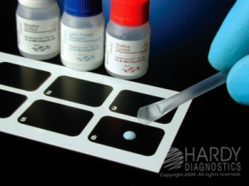
Rheumatoid Factor Latex Slide Test
The presence and the level of these antibodies in a serum may reflect the nature and severity of infection.

Slide 56
Test Result:
A test sample is considered to be positive when agglutination(clumping) is observed (slide labeled 2) when compared to the result of the negative test (slide labeled 5) on the right

Slide 57
Quality control and Quality Assurance
Bring ASOT Latex Antigen Suspension, Positive Control, Negative control and samples to room temperature (20–30ºC) before use.
Use fresh serum specimens and Plasma must not be used since fibrinogen may cause non-specific agglutination of the latex.
Do not use reagents pass the expiry date indicated.
Gently mix the reagents before use; avoid foaming.

Slide 58
Clinical Significance
RF are a group of antibodies directed to determinants in the Fc portion of IgG.
Although RF are found in a number of rheumatoid disorders, such as SLE, as well as in non-rheumatic conditions.
Its central role in clinic as an aid in the diagnosis of Rheumatoid Arthritis.

